Slide 1



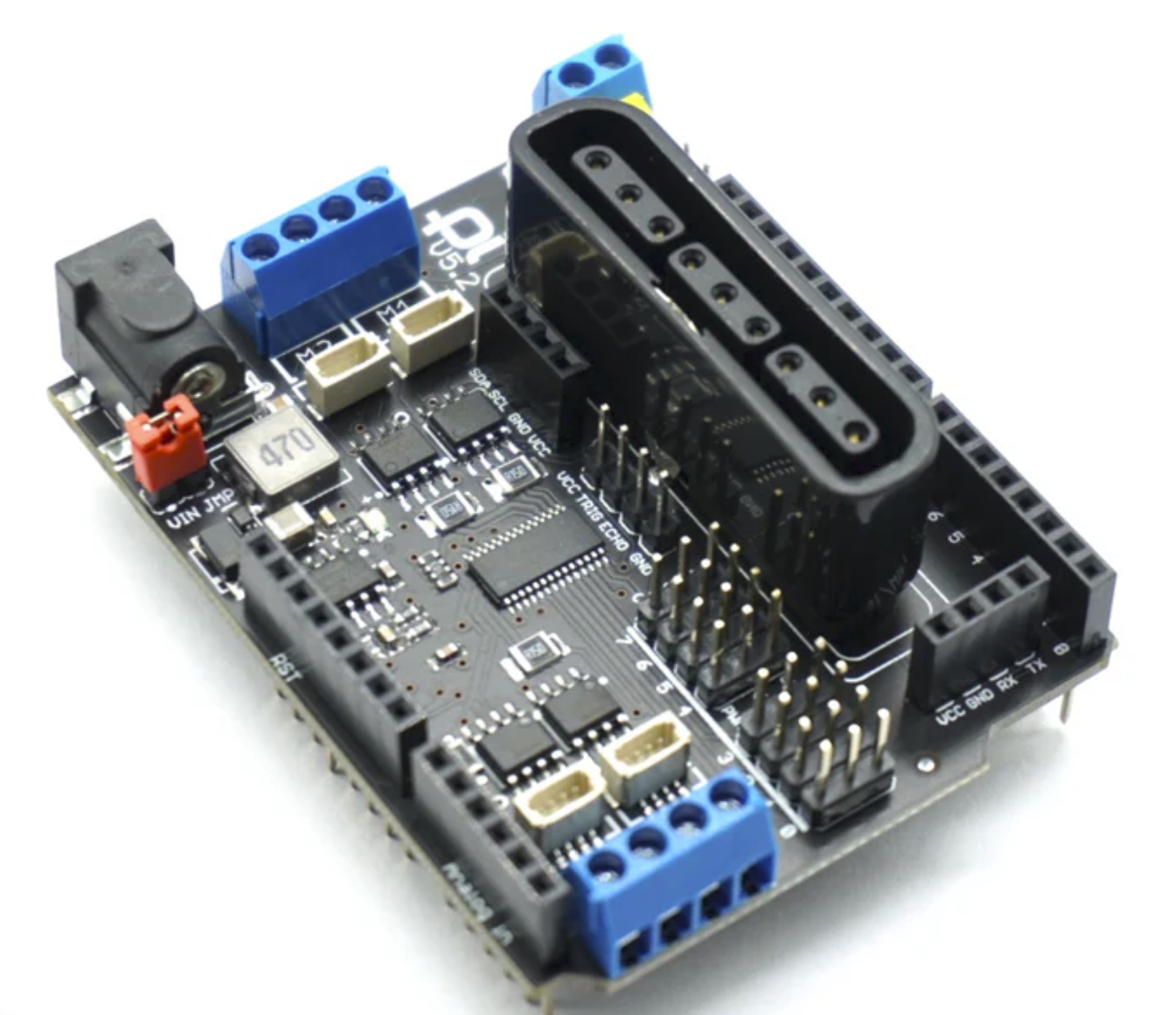
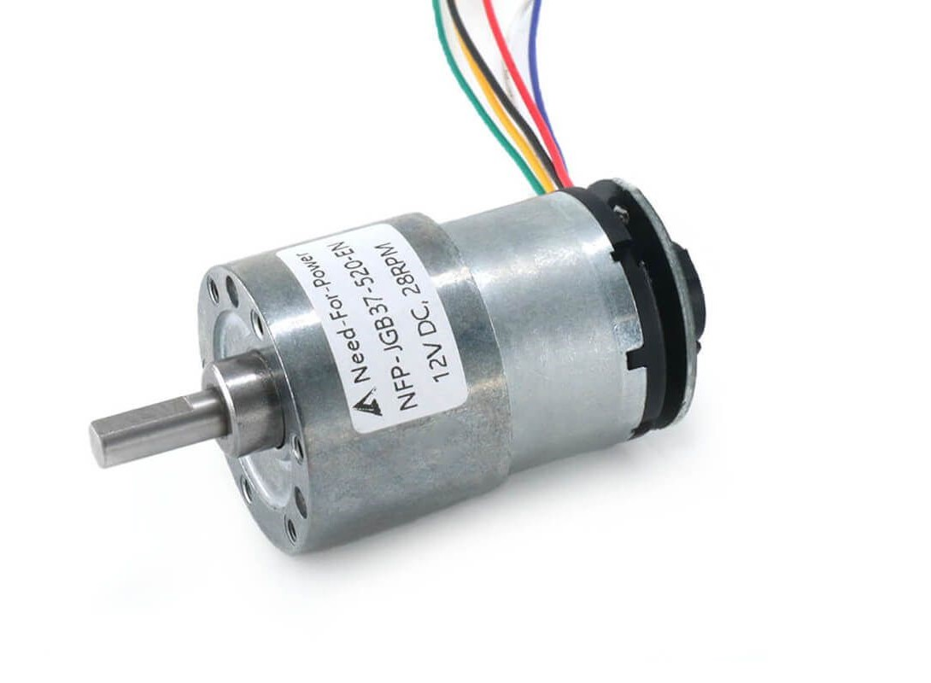
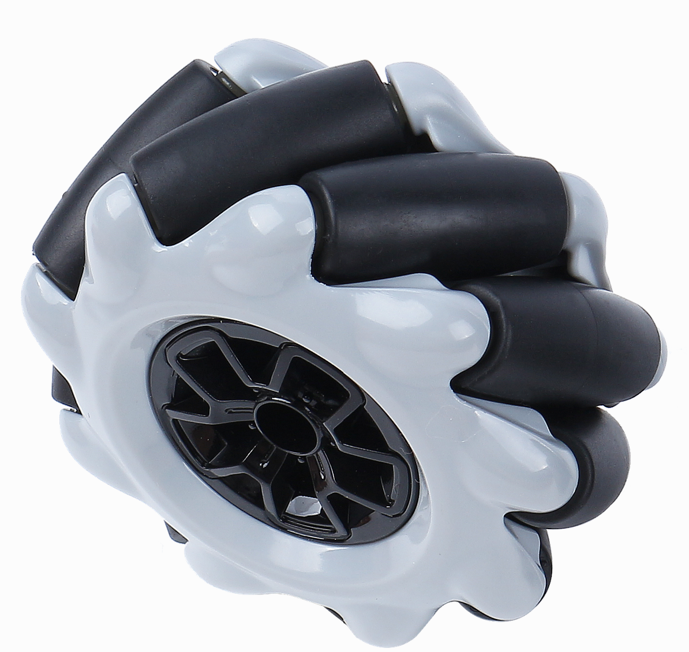
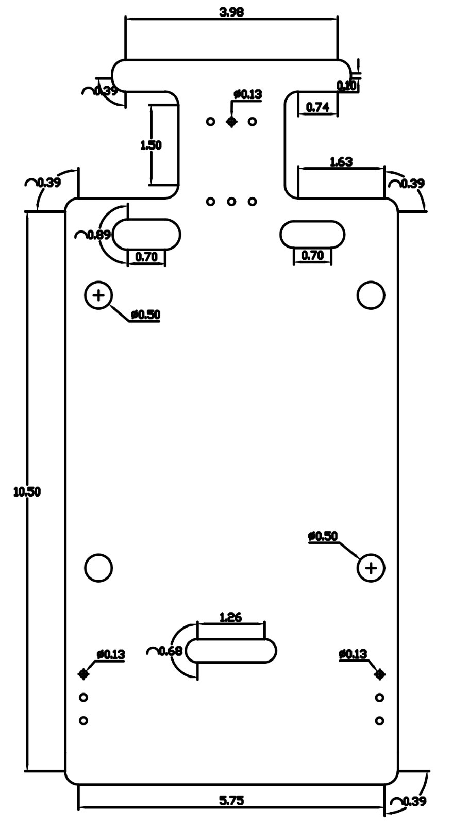
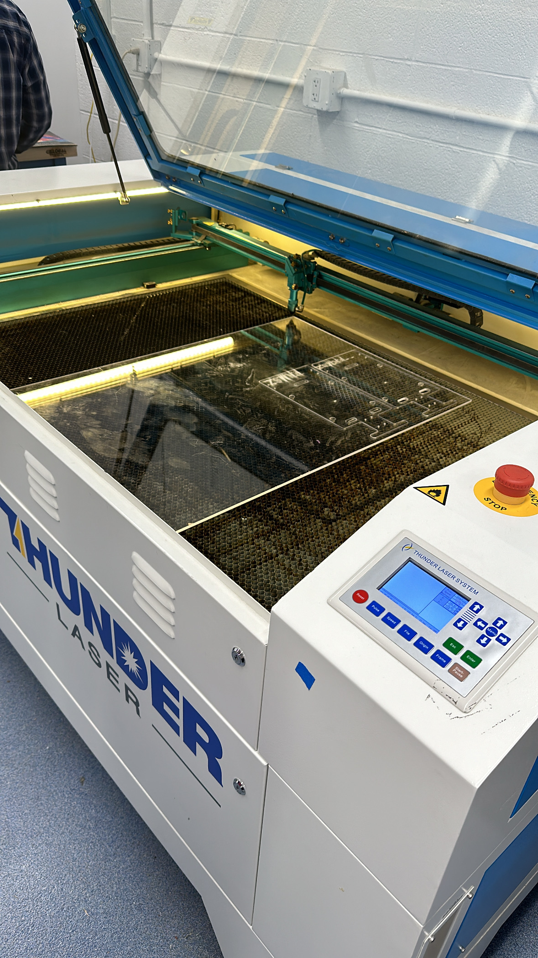
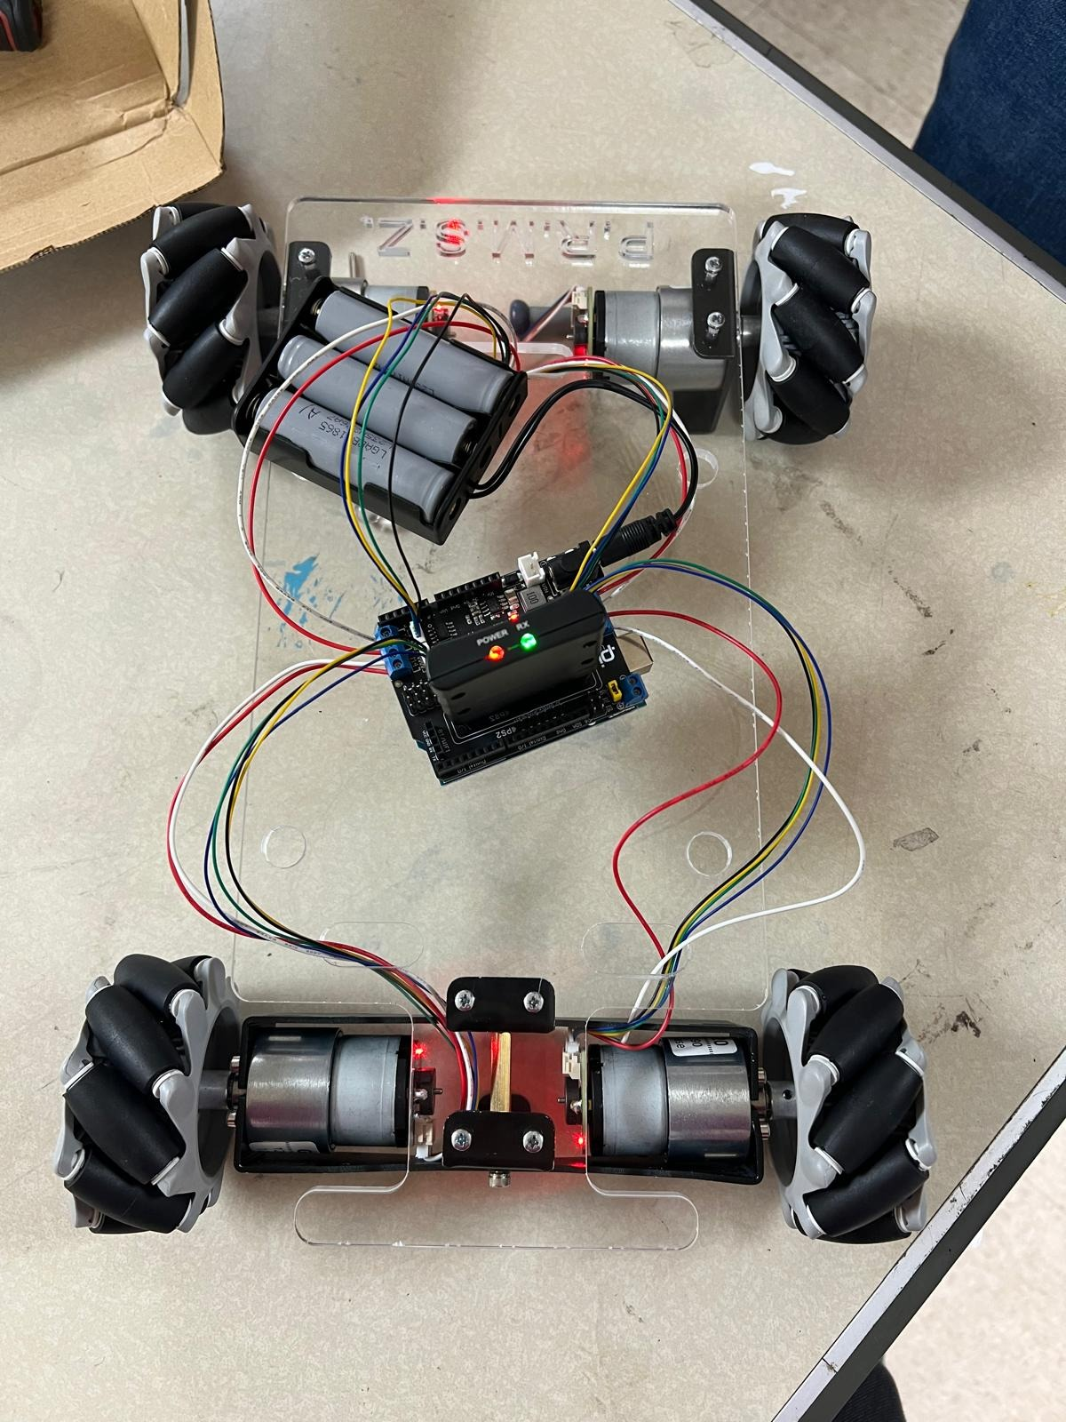
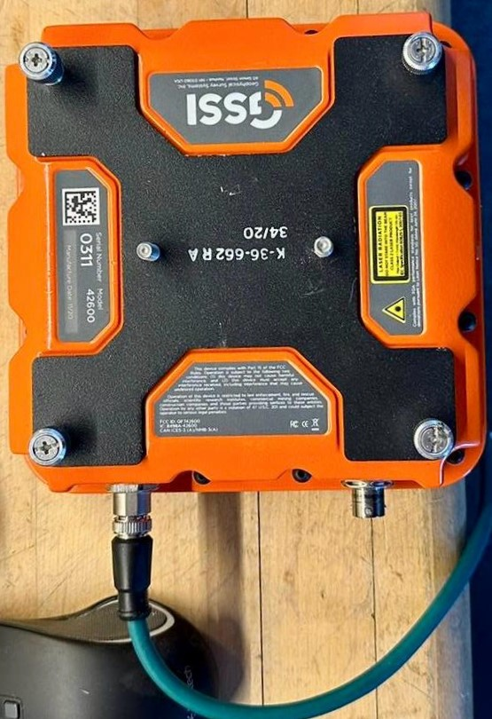
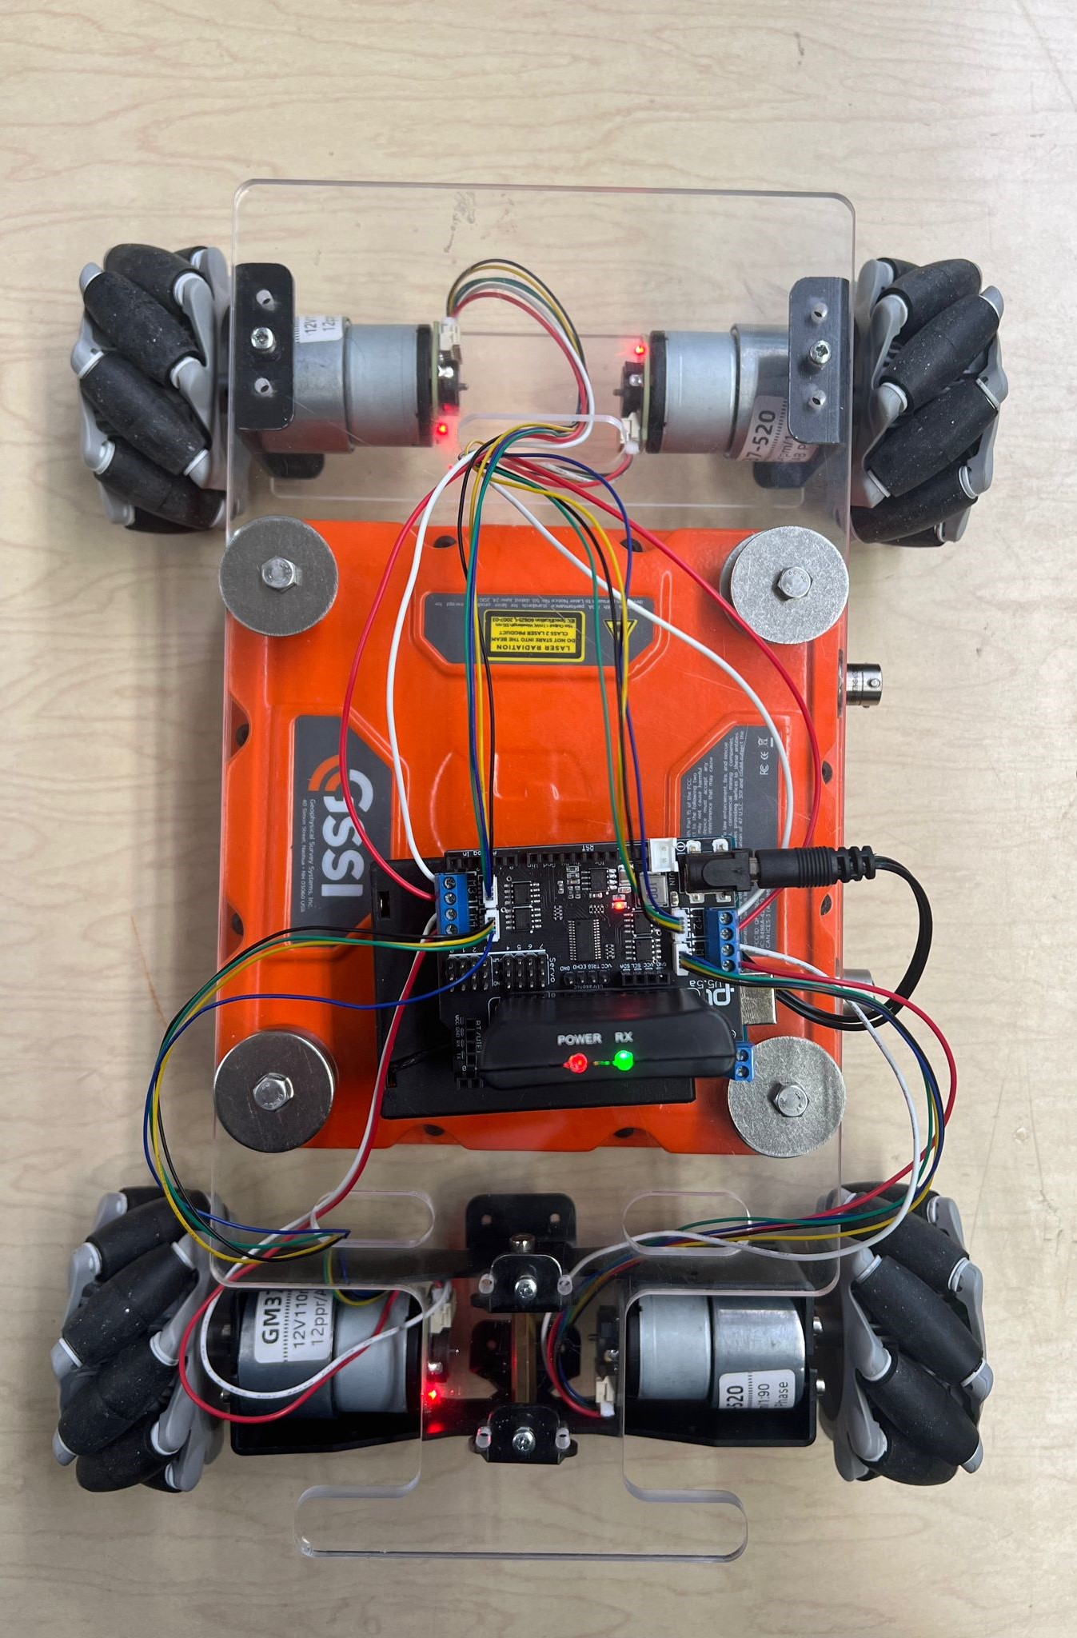
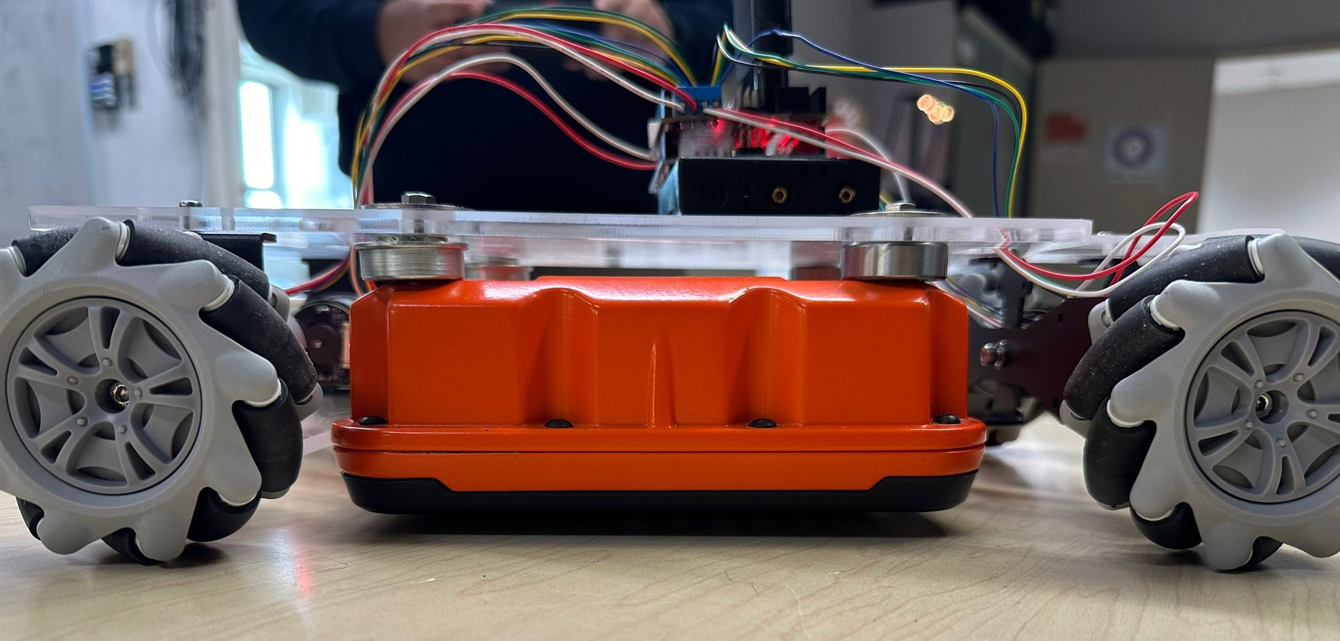
SubSurface Scout
Members: M. Hossain, M. Karim, P. Peiravani, S. P. Singh, and Z. A. Wallach - Mentor: Prof. Jizhong Xiao
Project Abstract
Design & Manufacturing
Key Components
This project presents the design, and construction of a mobile robot platform specifically for ground-penetrating radar (GPR) applications. The robot features a custom-built frame constructed from acrylic and aluminum, optimizing the balance between structural integrity and weight reduction to enhance mobility. Omnidirectional wheels allow customizable scanning patterns, enabling GPR data collection within the designated survey area. This mobile GPR platform offers a versatile solution for efficient data collection across various fields, including archaeology, geotechnical engineering, and utility mapping.
Using SolidWorks we designed the robot’s frame, utilizing tools like sketching and assembling features for accuracy. This involved creating a 3D model of the design, including dimensions and specifications, ensuring precision in our designs. After assembly, we exported the design as an image file for SolidWorks Design.
Next, we loaded our design file into the thunder laser software and specified the correct cutting settings, adjusting parameters such as power, speed, and frequency based on the material type and thickness, in our case, acrylic. These settings were determined through experimentation. Following the cutting process, we carefully removed the pieces from the bed and performed any necessary finishing touches or assembly to complete the fabrication of our robot's frame, ensuring accuracy and quality throughout the production process.
Arduino Uno
Arduino Uno
Drive Plate
Benefits
Infrastructure inspection, usage of GPR to detect anomalies in underground structures, thus, saving costs and minimizing disruption without excavation furthermore it provides a scalable approach to data collection and analysis.
It also aids in non-destructive archaeological exploration by uncovering hidden artifacts and structures beneath the surface, facilitating research while preserving historical site integrity.
Encoder Motor
Mecanum Wheels
GSSI GPR
Simulation
Utilizes electromagnetic waves to penetrate various materials beneath the ground surface, providing detailed information about buried objects, structures, and geological features.
Collect Mode: Distance
Scans per Second:150
Samples per Scan: 512
Depth Range: 20cm
Bits per Sample:32
This project showcases the operation of a robot programmed with Arduino. It enables essential movements (forward, backward, turning) and a pre-programmed routine. Pressing the select button triggers the robot to move forward for a set duration, followed by left and backward motions. This repetitive pattern confines the robot within a designated area, suitable for GPR scanning. Additionally, the robot's ability to start a programmed sequence by initiating a designated control mechanism demonstrates how flexible and easy it is to use, making it useful for many different jobs. This feature is especially helpful for tasks such as using GPR in tight spaces, where being able to move precisely is very important.
SubSurface Scout
Conclusion
Here's the finalized Subsurface Scout featuring integrated GPR and Arduino components, to optimize functionality. The Arduino serves as the core processor, governing the robot's tasks while the GPR capability enhances its ability to detect subsurface objects and terrain features.
This senior design project successfully demonstrates the feasibility and potential of a mobile, customizable platform for ground-penetrating radar (GPR) data collection. The custom-built robot, featuring a lightweight yet durable frame and omnidirectional wheels, effectively navigated the survey area and executed pre-defined scanning patterns for data acquisition. Building upon our design, future work may focus on refining scanning algorithms, integrating additional sensors like Ultrasonic sensors or LiDAR, and exploring machine learning algorithms for autonomous pattern adaptation. Investigating applications in new fields, such as environmental monitoring or infrastructure inspection, could further expand the platform's capabilities and contribute to advancements in various industries, ultimately enhancing efficiency, safety, and knowledge discovery.
Design Constraints
Material Selection: Consider material strength, weight, and availability.
Manufacturing Process: Check laser cutter capabilities, ensuring compatibility with material thickness, precision, tolerances, and alignment requirements.
Assembly Requirements: Focus on part fit, ease of assembly, and necessary fasteners or alignment features to streamline manufacturing and assembly processes.
Cost Constraints: Balance performance and cost within budget limits for materials, manufacturing, finishing, and assembly.

